Slide 1
Suicide and Self-Harm Prevention in Schools
Molly Adrian, Ph.D.
Aaron Lyon, Ph.D.
University of Washington
Substance Abuse and Mental Health Services Administration
U.S. Department of Health and Human Services
Location of presentation

Slide 2
Disclaimer Slide
This webinar was developed [in part] under contract number HHSS283201200021I/HHS28342003T from the Substance Abuse and Mental Health Services Administration (SAMHSA), U.S. Department of Health and Human Services (HHS). The views, policies and opinions expressed are those of the authors and do not necessarily reflect those of SAMHSA or HHS.

Slide 3
Goals for this presentation
Learning objectives:
Gain an understanding of what self-harm and the spectrum of behaviors related to self-harm.
Learn about benefits and challenges of school-based prevention efforts for self-harm and suicide
Learn about best practices from Multi-tiered System of Support and SAMHSA to support prevention of self-harm.

Slide 4
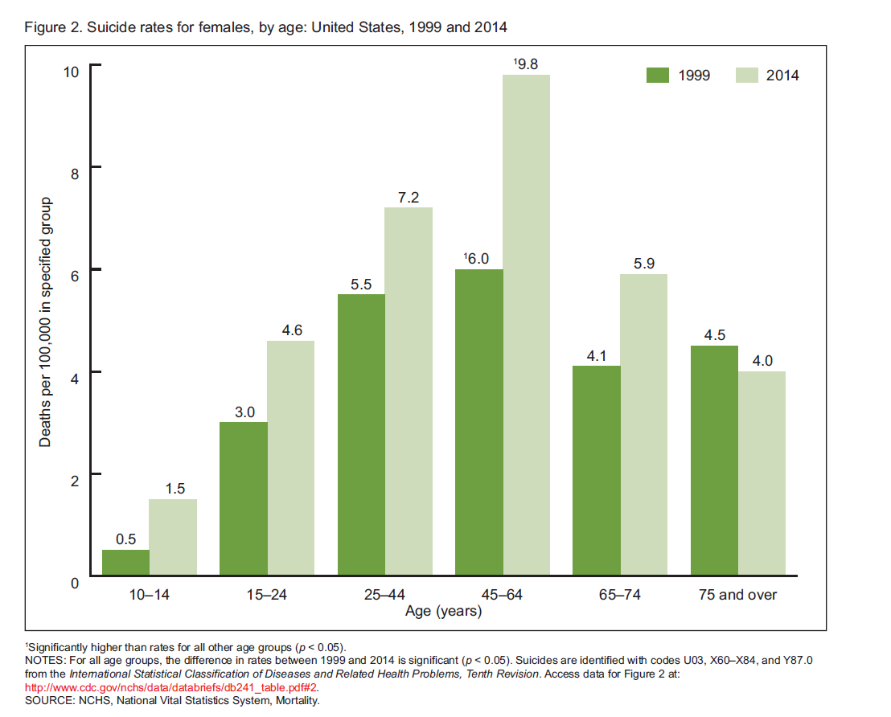
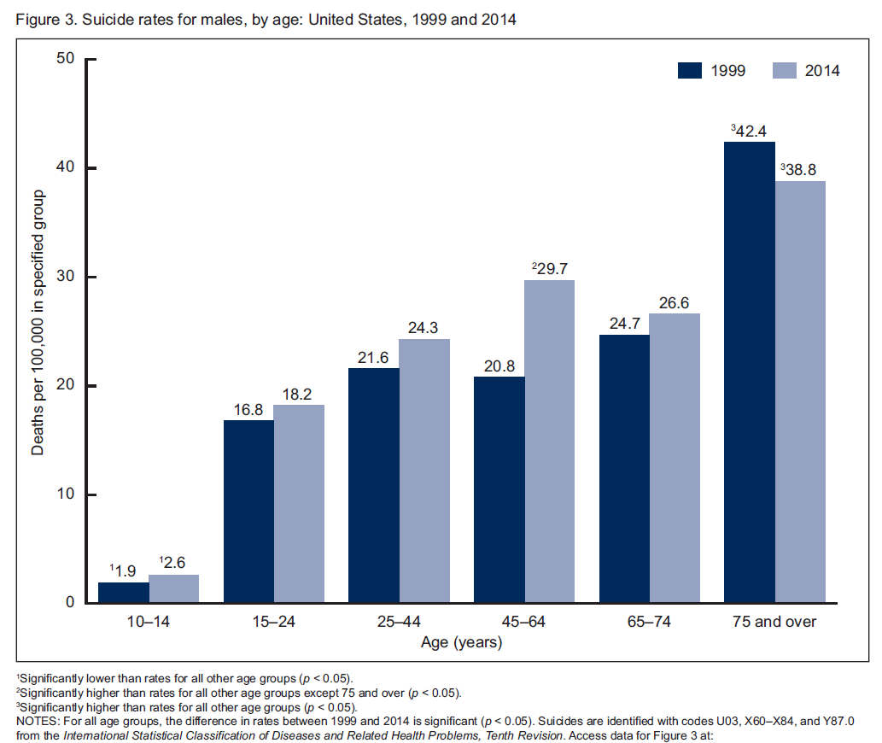
Suicide is a Public Health Problem
Suicide Rates from National Vital Statistics System, 1999-2014 (Curtin et al, 2016)
Notes:
An important public health priority for all Americans, unfortunately
Indigenous peoples have disproportionately high rates of the spectrum of suicide behaviors, ~50% higher than US general pop in adolescent and young adult populations
Current efforts have failed to decrease suicidal behaviors
Wexler et al. Advancing Suicide Prevention Research With Rural American Indian and Alaska Native Populations. American Journal of Public Health: May 2015, Vol. 105, No. 5, pp. 891-899.
North America’s
Indigenous peoples have disproportionately
high rates of suicide deaths, attempts, and
ideation, and suicide deaths are approximately
50% higher for AI/AN people than for White
people.1,3 However, AI/AN elder suicides are
quite rare. Suicide is the second leading cause
of death among AI/AN adolescents and young
adults, and their rate of suicide is 2.5 times as
high as the national average across all ethnocultural
groups.2 AI/AN young men are particularly
vulnerable4; the Centers for Disease
Control and Prevention has reported that
AI/AN youths aged 10 to 24 years have the
highest suicide rates of all ethnocultural groups

Slide 5
Range of Suicide Risk Behaviors
Behavior | High School Estimates (YRBS, 2015) | Definition (Posner et al., 2009) | Risk/Relation to Suicide (Fowler, 2012)
Suicide Attempt | 8.6% | A potentially self-injurious behavior associated with at least some non-zero intent to die. | *strongest predictor; method critical to understanding risk * Multiple attempts * Moderate false positive rate
Interrupted Attempt | ? | Person begins to take steps toward making a suicide attempt but somebody else stops them prior to any self-injurious behavior. | Unknown predictive strength
Aborted Attempt | ? | Person begins to take steps toward making a suicide attempt but stops themself prior to any self-injurious behavior. | Unknown predictive strength
Non-Suicidal Self-Injury | 13-21% (Barrocas, 2012) | Self-injurious act without any intent to die. Often associated with other goals, such as to relieve distress. | *Strong predictor, potentially equal to suicide attempt
Suicidal ideation | 17.7% | Thinking about killing self; ranges from passive (wish to be dead) to active (thoughts about killing oneself). | * High false positive risk;
Notes:
Many studies have blurred the distinction between self-harm, attempted suicide, and completed suicide. Although the focus of this research is on NSSI, it is important to understand the commonalities and differences between NSSI, suicidal ideation, and suicide attempts. Suicidal behaviors have been declared a significant health problem, with suicide being one of the leading causes of death in the world (World Health Organization, 2002). This is particularly relevant for adolescents in the United States where suicide is the third leading cause of death among youth between the ages of 10 and 24, and each year approximately 1,600 teenagers die by suicide (Gould, Shaffer, & Greenberg, 2003; US Public Health Service, 1999). Suicidal behaviors include completed suicide, suicide attempts, non-suicidal self-injury, and suicidal ideation. The behaviors are differentiated by the behavioral aspects and intent. Although NSSI is explicitly not suicidal in intent, it is included in this grouping of behaviors because the nature of intent is extremely difficult to assess. Moreover, self-injury often occurs with ambivalence or with swiftly changing intent. Second, a behavior that begins as suicidal in intent can evolve into non-suicidal and vice versa. Third, NSSI can become suicidal regardless of one’s intent (Berman, Jobes, & Silverman, 2006). Some researchers do not distinguish between acts of self-harm and suicide attempts (e.g., Linehan, 1993 who uses parasuicide to encompass both suicide attempts and self-harm) due to the complexities in assessing intent. Recent research on different forms of self-injurious behaviors increasingly supports differentiating NSSI from those behaviors associated with suicidal intent. Specifically, Linehan’s (1986) overlapping populations model, which postulates that individuals with suicidal ideation, NSSI, and suicide attempts represent distinct behavioral phenomena with different etiologies, correlates, courses, and functions, is receiving increasingly empirical support (Brown, Comtois, & Linehan, 2002; Favazza, 1989; Nock & Kazdin, 2002). Moreover, the treatment implications vary based on the function of the behavior; thus, discriminating these behaviors in research and in practice is imperative. Even though these behaviors are distinct, there is overlap with estimates suggesting that 40-60% of those who commit suicide have a history of engaging in NSSI (Foster, Gillespie, McClelland, & Patterson, 1999; Hawton & Fagg, 1988). Due to the importance of NSSI as a potential identifier for those at risk for suicide and the psychological and physical costs of such behavior, research is needed to understand the specific etiological mechanisms through which NSSI is expressed.
Estimates from clinical and non-clinical samples suggest that NSSI is pervasive and perhaps increasing in prevalence (Hawton & Fagg, 1992
NSSI is more common than previously assumed with up to 9-14% of high school students (Ross & Heath, 2002; Skegg, 2005) and up to 38% of college age students reporting that they have engaged in NSSI at least once, with many being repeaters of NSSI (Gratz, 2002).
Alarming rates have been documented in clinical samples with approximately two-thirds of adolescent patients engaging in this behavior (DiClemente, Ponton, & Hartley, 1991; Sim, Adrian, Zeman, Cassano, & Friedrich, 2009).

Slide 6
Risk Factors
Distal Risk Factor | Proximal Risk Factor
Prior self-injury | Stressful Life Events- particularly those with high levels of shame/embarrassment
Psychopathology (Esp. Comorbid Depression, Panic, Substance Use, Conduct Disorder) | Accessible Means
Impulsive-Aggressive Traits | Intense Affective State+ Sleep Disturbance
Race/Ethnicity (likely related to social conditions including assimilation, disruption of social structure, minority stress) | Academic /Employment Difficulties
Disturbed Family Context/Family history of suicide /Early life adversity | Functional Impairment from Physical Disease/Injury
Male | Suicide in Social Milieu
Sexual Minority | Talking about suicide, burden to others, purposelessness
Abuse
Notes:
We are not able to predict in advance which individuals adolescents will attempt suicide. It is, in legal terms, an unforeseeable event. The current state of risk assessment is imperfect.
Effectively assessing suicide risk is dependent on the availability of sensitive and specific measures of long-term risk factors,
short-term warning signs, and an appreciation for the complexity and variability of suicide risk over time. This does not exist. clinicians are
nonetheless responsible for assessing suicide risk

Slide 7
Multiple Suicide Prevention Strategies Needed
Christensen (2016) JAMA viewpoint
Notes:
MOLLY
Despite efforts to address self-injury and the devastating impact of death by suicide, rates have remained relatively unchanged, underscoring the critical need for innovative approaches to aid effective suicide prevention strategies.¹²
Christensen highlights that we need to change the Direction of Suicide Prevention Research for True Population Impact

Slide 8
Reducing Suicide Risk
Indicated Strategies
Selective Strategies
Universal Strategies
Notes:
AARON THIS IS THE SAME AS THE LAST SLIDE BUT PRESENTS BOTH ATTEMPTS AND DEATHS__ THE LAST IS JUST DEATHS
Healthcare is not suicide safe. Many of the holes identified are that 1) suicidal people are not screened. 2) When screened, GPs do not always know what concrete steps to take for safety. 3) we need to be prepared to help in treating suicidality instead of sending to inpatient care and hope for the best, 4) get empirically-informed treatments to clients

Slide 9
Schools are an Important Context for Self-Harm Prevention
Mental health and academic problems commonly co-occur (DeSocio & Hootman, 2004; Roeser et al., 1999)
Schools = the most common site for the identification and treatment of youth mental health problems (Costello et al., 2014; Farmer et al., 2003; Lyon et al., 2013)
~20% of all students receive SMH services annually (Foster et al. 2005)
Schools improve service access for
traditionally underserved youth
(Kataoka et al., 2007; Lyon et al., 2013)

Slide 10
Importance of the School Context
Service use across sectors by race/ethnicity…
care
Lyon et al. (2013)
Notes:
AARON
-Service use by 9th graders experiencing symptoms of depression
-Controlling for gender, depression severity, and SES, differences were still found by race/ethnicity for specialty MH, but not for school MH
10

Slide 11
Importance of the School Context
High schools provide an accessible setting for identifying youth at-risk (Farmer et al., 2003)
School-based screening/assessment methods could be substantially improved (Romer & McIntosh, 2005)
Practical/staffing concerns
Only 2% of schools carry out routine universal emotional health screening

Slide 12
Multi-Tiered System of Support (MTSS) Provides a Framework for Organizing School Interventions
Notes:
within schools through applications to both academics and
behavior, with many of these efforts now being integrated
given the known link between mental health and academic
achievement (Taylor, Oberle, Durlak, & Weissberg, 2017;
Durlak, Weissberg, Dymnicki, Taylor, & Schellinger, 2011).
School-based suicide prevention programs, as well, have
been embedded within multi-tiered frameworks that have
identified interventions at the universal (Tier 1), selected
(Tier 2), and indicated (Tier 3) level (Miller et al., 2009;
Miller, 2010; Erbacher et al., 2015).
MTSS here
(Wyman & Upstream Suicide Prevention
Workgroup, 2012). According to Wyman (2014), an
upstream approach to suicide prevention should incorporate
programs during childhood and adolescence that build
developmentally appropriate skills and supports, a goal
shared by multi-tiered systems of support such as positive
behavior interventions and supports (PBIS).
Although the
impetus to engage in district-wide suicide prevention efforts
has typically followed the tragic death of a student and subsequent
community response, a majority of states now mandate
suicide prevention training for school personnel in some
capacity (Kreuze, Stecker, & Ruggiero, 2017).

Slide 13
SAMSHA Preventing suicide: Toolkit for schools

Slide 14
Tier 1: Education for Staff, Parents and Students
Students | Parents | Staff
Suicide Specific Information (Signs of Suicide, Sources of Strength) | Information about programming for youth | Education Programs like QPR, Asist,
Universal Screening | Information about warning signs | Education regarding crisis response procedures
Integrated SEL Curricula
Notes:
This occurs primarily through the training of school personnel
and students to be “gatekeepers.” These trainings teach
risk factors, warning signs, and help-seeking behaviors,
should students be concerned about themselves or a peer.
Signs of Suicide were significantly less likely to report
suicidal behaviors than controls and demonstrated improved
knowledge about suicide and suicide prevention (Schilling,
Lawless, Buchanan, & Aseltine, 2014). High school students
had similar results, as well as significantly fewer suicide
attempts among those who participated in Signs of Suicide
compared to controls (Schilling et al., 2016).
Wasserman et al. (2015) conducted the Saving and Empowering
Young Lives in Europe (SEYLE) study, a large-scale
cluster-randomized controlled trial across 168 schools in 10
European counties. They compared the impact of teacher
gatekeeper training (i.e., QPR), student curriculum (i.e.,
Youth Aware of Mental Health Programme [YAM]), student
screening (i.e., ProfScreen), and a control group on
suicide attempts at 3 and 12 months post-intervention.
While no differences were found after 3 months, there were
significant decreases in self-reported suicide attempts and
severe suicidal ideation after 12 months for students who
received the YAM intervention. More specific outcome data
on QPR via a randomized controlled trial found that trainees
reported significantly higher efficacy, with those reporting
the lowest scores at baseline experiencing the greatest gains
(Wyman et al., 2008). However, identification of at-risk
youth increased most for those staff members that typically
engaged youth in conversations about mental health or suicide
prior to receiving the training, and no impact on youth
access to mental health services at follow-up was found
(Wyman et al., 2008).

Slide 15
Effects of Education Programs
Parent and Staff Education:
Garrett Lee Smith legislation: gatekeeper training can be effective in reducing suicide attempts and death by suicide
Training efforts must be ongoing to yield reductions in suicide-related outcomes (Garraza et al., 2015)
Student Education:
Studies suggest that interventions designed to enhance students’ skills may be particularly important for school-based suicide prevention efforts (Singer et al., 2015 for review).

Slide 16
Universal Screening
Effective Identification is Essential for Suicide Prevention
Screening for suicide risk is challenging
Assessment places significant resource demands on the gatekeepers and clinicians
Feasibility is a concern
Effects of emotional health screening leads to improved detection, but connection to indicated supports demonstrates mixed results
Notes:
Best practices for
school-based screening for behavioral health and suicide risk
have not been established, but discussion in the literature
has focused on the feasibility of screening, selection of an
appropriate screening tool, and the accessibility of referral
options for identified students, among other considerations
(Katz et al., 2013; Robinson et al., 2013). While universal
behavioral health screening may be a way to identify
students before they exhibit suicidal thoughts and behaviors,
in line with upstream approaches, there are currently
no universal screening measures for suicide.
Universal screening for social, emotional, and behavioral
concerns, however, is an established practice through multitiered
systems of support such as response to intervention
(RtI; Brown-Chidsey & Steege, 2005), and many valid and
technically adequate tools exist for schools to choose from. universal
screenings have been found to improve detection of children
likely to benefit from early mental health intervention, with
only those students in need being referred for more specialized
treatment by mental health specialists (Essex et al.,
2009)..

Slide 17
Tier 2: Selected Interventions
Students | Staff
Assessment following screening | Training related to key duties in a crisis
Supports for Indicated Populations | Identification of students
 | Provision of appropriate assessment and supports
Notes:
Students:
School district policies should
specify who is qualified to conduct the screening and that
school staff members know where to refer students should
they be concerned. Suicide screens can utilize more formal,
validated measures such as the Columbia Suicide Severity
Rating Scale (Posner et al., 2011) or involve a series
of simple questions, such as “are you having, or have you
had, thoughts of suicide?” Students who screen positive for
suicide risk should be referred for a comprehensive risk
assessment
STAFF
Tier 2, staff education and training should focus on school
personnel that are responsible for crisis preparedness and
response, including school mental health professionals (i.e.,
school counselors, school psychologists, school social workers)
and administrators. At this tier, the focus is on the identification
of students that may be at risk of suicide, as well as
the provision of appropriate supports and services for these
students. Therefore, staff training at Tier 2 may also incorporate
any training required for select staff members to provide
small group instruction or run small group intervention

Slide 18
Tier 3 : Indicated Interventions
Students | Parents | Staff
Individual intervention- school-based, safety planning, referrals |  | Responding to non-lethal suicidal behavior
 |  | Responding to death by suicide
Notes:
individualized interventions such as safety planning, procedures,
and strategies for the ongoing monitoring of students
upon reentry after hospitalization, and postvention, or the
response to a suicide death.

Slide 19
Contemporary Research-to-Practice Gaps
Benefits of decades of research to routine service have been negligible
It takes 17 years for just 14% of original research to benefit practice (Balas & Boren, 2000)

Slide 20
Implementation Gap

Slide 21
Implementation Determinants
Factors that obstruct or enable changes in professional behaviors or service delivery processes (i.e., barriers and facilitators) (Krause et al., 2014)
Helpful determinant resources
Conceptual frameworks (e.g., CFIR, TDF, etc.)
Taxonomy of determinants (Flottorp et al., 2013)
Specific measures – e.g., ILS (Aarons et al., 2014), ICS (Ehrhart et al., 2013), OSC (Glisson et al., 2008), etc.

Slide 22
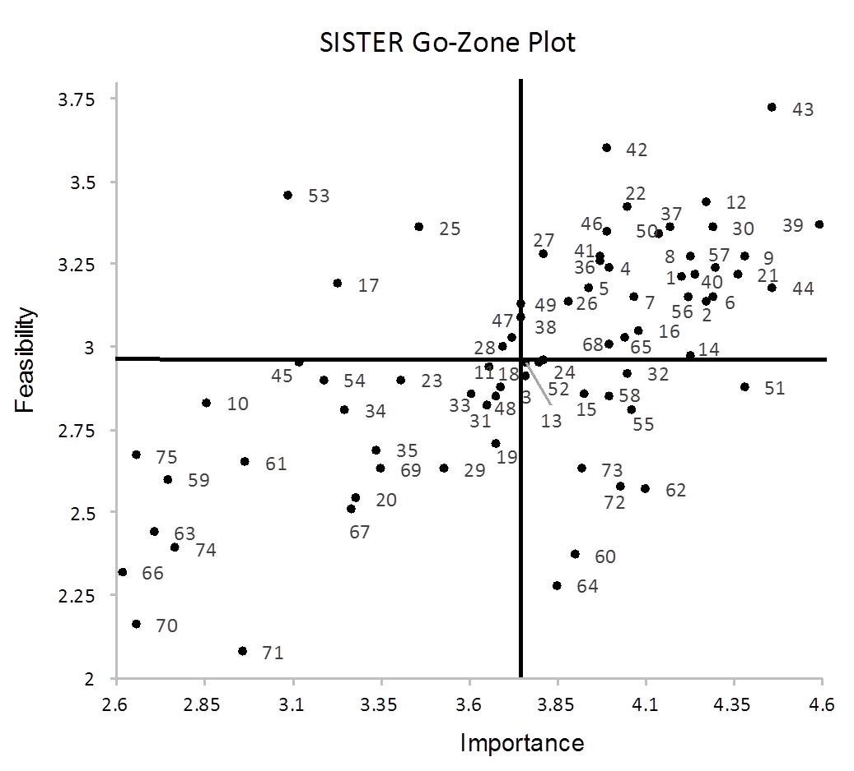
Implementation Strategies
#43. Make training dynamic
Methods or techniques used to enhance the adoption, implementation, & sustainment of practices (Powell et al., 2012; Proctor et al,. 2013)
#42. Distribute Educational Materials
#70. Change school or community sites
#71. Create or change credentialing / PD standards
Lyon et al. (under review)

Slide 23
Implementation Outcomes
Effects of deliberate actions to implement new practices (Proctor et al., 2011)
Implementation outcomes
Service outcomes
Student outcomes
Acceptability
Adoption
Appropriateness
Costs
Feasibility
Fidelity
Penetration
Sustainment
Efficiency
Safety
Effectiveness
Equity
Student-centeredness
Timeliness
Satisfaction
Functioning
Symptoms
(Proctor et al., 2011)

Slide 24
Your role in helping youth
Unique position to intervene!
Core tasks are to:
Ask the question!
Understand patient’s self-harm
Assess severity of behavior
Present options for alteratives
Monitoring the status, ensuring continuity of care, and reconnect with behavioral health as needed

Slide 25
Ask the question
Common myth that asking teens about self-harm may be iatrogenic
There is NO data to support this myth
Ask the question and practice asking
“Have you thought about harming yourself?”
“Have you harmed yourself?”

Slide 26
Understanding Self-Harm: Communication Strategies
Ask questions needed to assess the behavior can also generate change (e.g., Motivational interviewing)
Facilitate discussion
Prompt patient to think about change
Example questions:
This behavior must be serving a function for you. Are there disadvantages to continuing?
Is there anything that’s motivating you to stop hurting yourself?
There are a lot of options for getting help for this problem. What do you think you would need to stop?

Slide 27
Understanding Self-Harm (continued)
Use a matter of fact, curious yet dispassionate communication style
Validation – a communication strategy that communicates understanding and their actions make sense given their current context
Validate the valid: find the kernel of truth
It has been really stressful and you are not sure how to handle the stress.
It’s hard to think of other solutions in the moment of stress because cutting has been immediately effective in the short term, though it has problems in the long term.
Notes:
Monitoring one’s own response to patient's self-injury as to not reinforce nor ignore this behavior is likely to facilitate better quality information to base risk management decisions.

Slide 28
Core Assessment Questions: STOPS FIRE (Kerr et al., 2010)
What to Assess | How to Assess | Indication of High Risk
Suicidal Ideation | Do you have thoughts of killing yourself? Does this occur when you are engaging in [bx] or other times? | Intense thoughts of suicide while NSSI ; Thoughts of suicide before/ after NSSI
Types | What have you used? What ways do you injure yourself? | >3 methods
Onset | When did you first begin X? | Early onset; > 6 mo
Place/Location | What parts of your body have you X? | Genitals; face
Severity | Has X ever caused bleedings/ scarring? Have you ever gone to the ED due to X? | Hospitalization, reopening of wounds
Function | What does X do for you? How do you feel before? After? | Any relationship to suicide
Intensity | How strongly would you rate your urge to X on a typical day (0-100)? | 70 or above
Repetition | How many times have you done this? | > 10
Episodic frequency | How often do you do this in a typical week? | Multiple times per week; Multiple times per episode
Notes:
Front line providers increasing presented with youth who self-injure

Slide 29
Management and Treatment
No FDA medications for treatment of self-harm
Several promising psychotherapy practices (Ougrin et al., 2015)
Collaborative Assessment and Management of Suicidality
Dialectical Behavior Therapy
Mentalization
Problem solving therapies
Common focus on observing and describing thoughts and emotions; more accurately interpret one’s own/others behavior
Skills related to mindfulness, emotion regulation and interpersonal effectiveness

Slide 30
Conclusions
Clinicians working in high schools are likely to encounter teens who self-harm
Clinicians can be prepared to encounter this behaviors by:
Aligning their MTSS and SAMSHA frameworks to support students
Exploring and understanding their own reactions
Understand the function and course of self-harm
Be prepared to address the problem with validation and motivational interviewing strategies
Refer when teens are willing, harm is dangerous or repetitive, or indicates high risk
Notes:
School mental health professionals have training and background
both in mental health and social, emotional, and
behavioral strategies, as well as in multi-tiered systems of
support and are therefore best equipped to lead school-based
suicide prevention efforts.

