Slide 1
It’s My Life:
Peer Partners
Patrick Hendry

Slide 2
One of the leading risks for overall poor health is social exclusion and loneliness.
In order to combat the devastating effects of loneliness and to assist people seeking connections to the community and a fulfilling social life, MHA created It’s My Life: Peer Partners.
Peer Partners is structured as a support group that is facilitated by a peer specialist who works with the members to develop a social plan that reflects the type of life they would like and are willing to make substantial life changes to achieve.
It’s My Life: Peer Partners is a unique combination of peer support, self-directed care, and psychiatric rehabilitation.
Heavy on the peer support!

Slide 3
When surveyed to become new members of the group, the nearly unanimous goal was to have at least one friend.
Mental health problems are one
of the leading
causes of loneliness and isolation.
Sometimes it is because we are
afraid to be around other people, and sometimes it is because other people are afraid to be around us.
Research has shown that social connectivity is an extremely powerful tool for achieving recovery and creating opportunities for having a life that is meaningful to the individual.

Slide 4
“Traditional approaches such as medications, hospitalization, and dynamic psychotherapy have a limited effectiveness when applied to the socialization and work aspects of individuals with psychiatric disabilities.” (Chan et al. 1998)
Our goal with Peer Partners is to help build networks of friends and intimate relationships, thereby creating a strong social support system.
Positive social connections increase self-esteem and our feelings of self-worth. Self-esteem and self-worth are critical to self-love.
“To love oneself is the beginning
of a live-long romance.”
Oscar Wilde

Slide 5
Separation is what we have, imposed by society and ourselves. Integration means we can live, work, and play in the community but we are often not a real part of it. “Community housing” is often a gateway to integration without inclusion. What we want is INCLUSION.

Slide 6
Many programs attempt to provide people with social skills training. Most of them have very limited success in really connecting people to friends and the community.
Peer Partners is different:
When people join the group they participate in a quality of life interview, (Personal Outcome Measures, POM) that identifies the presence or absence of important social and personal assets. The results are discussed with the individual.
Each participant is asked to provide accurate information on hospitalization and emergency room visits in the previous 2 years. This information is strictly confidential.
We also want the participants to let us know what types of services they are currently receiving and to notify us if there are any changes
The program is structured as a support group model. During the first few weeks people share their thoughts about feeling “separate” or “excluded” from the community around them.
As in any support group where people share intimate thoughts and feelings a feeling of comradery is born.
Occasionally there are negative feelings or even confrontations within the group. IT IS IMPERATIVE THAT EACH FACILITATOR READ THE MHA SUPPORT GROUP FACILITATION GUIDE. Most of you will already have experience in facilitating groups. Every group should create a “comfort” agreement.

Slide 7
Continuation of support group activities
In the first 2 groups the facilitator explains the program and all of the forms and paperwork associated with it.
The facilitator encourages the members to team up.
The facilitator takes everyone through a goal setting process.
In order to set “real” goals, ones that people are willing to make significant changes in their lives, the goal must “touch” the person very deeply.
Upon completion of the goal setting, the facilitator assists the group in helping each other set up “doable” action plans to be worked on before the next group. The action plans are based on smaller goals that will lead the person to achieving their overall goal.
As each person develops their plan the group helps them to assess how confident they are that they will be able to accomplish it within the time they set. If they aren’t sufficiently confident the group helps them to alter their plan in order to increase their confidence.
Note: We use the IMPACT goal setting plan from WHAM. If you are unfamiliar with this method the MHA Program Coordinator will provide you with the necessary information and training

Slide 8
At each group the facilitator asks the group to choose one of the skill building tools provided and then works with the group for 20-30 minutes to learn and practice the new skill.
The group forms partnerships to assist each other when they work on completing their “action plans”. Depending on the size of the groups and internal group dynamics these partnerships can vary in size from two people to as many as four.
The facilitator is available by phone or email during the time between group meeting to provide information and suggestions.
The “action plans” involve going out into the community and practicing strategies and skills for making new connections.
One valuable strategy is for people to look for activities in the community that will attract other people with similar interests.
Each participant is given a monthly stipend of $30-35 to only be used for social activities. They are required to provide a projected budget for how they intend to use the funds.

Slide 9
Participants are responsible for keeping receipts or other records of how they spent their budgets. Appropriate forms are available in the program toolkit.
At the next meeting each person has an opportunity to discuss the successes and/or barriers they encountered in achieving their “action plan”. The group provides constructive input and suggestions.
At every meeting the facilitator assists in learning new social skills.
Participants are asked to keep “guided” journals of their thoughts and activities each week and provide the facilitator with a copy each month. This is a voluntary activity that is to be encouraged but not required.
Each month the participants provide the facilitator with their receipts and a copy of their planned budget for the next month.

Slide 10
Depending on the size of the group, facilitators are asked to see that a new Personal Outcome Measure (POM) interview is done each 6 months.
It is a requirement that a POM interview is done before participation in the group begins, and another is done when the person decides to leave the group or the group completes a one year cycle.
Groups will be provided with satisfaction surveys that can be filled out anonymously. These completed surveys will be provided to the grantor.
It is important that all of the material provided to the grantor, as per the MHA MOU signed by both parties, have had all individual identifications removed prior to sending in.

Slide 11
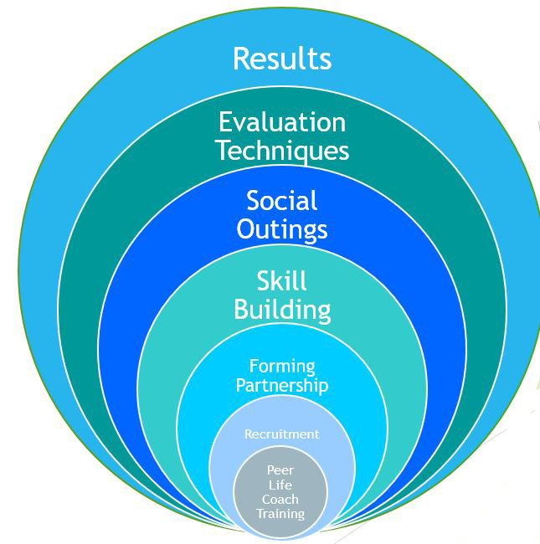
Peer Partner Model
Evaluation Techniques

Slide 12
Peer Partners in Review: Recruiting Participants
Eligibility Requirements:
Need for services is determined by completion of POM interview.
At least 18 years of age
Competent and able to give informed consent.
Able to manage personal finances, establish goals and action plans.
Willing to adhere to all agreed upon Participant Responsibilities.

Slide 13
Peer Partners in Review: Forming Partnership
Open and Authentic
Participation is voluntary
Confidentiality is kept (HIPAA)
Professional Boundaries
Appropriate use of Social Budget funds and requirements for keeping records. All expenditures must correlate to the social goals, action plans, and social budget. Changes must be made with facilitators input.

Slide 14
Review of Skill Building
The purpose of the skill building exercises is to help the participant:
Gain the ability to sustain personal and social growth
Strengthen their interaction with themselves and others.
Tools used for skill development:
Group gatherings with all participants
Role Playing
Games
Worksheets and informational literature

Slide 15
Peer Partners Social Outings
People make choices that suit them
Finding activities that allow you to be around other people with similar interests
Activities encourage social interaction

Slide 16
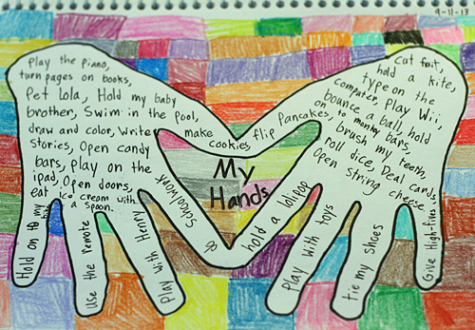
Guided Journaling
C
R
E
A
T
I
V
E
Guided journaling answers questions and reminds us of our successes and barriers.

Slide 17
Guided Journals
From the journal entries it was observed that using skills attained through the program skill building exercises, participants learn to approach new people, initiate conversation, and create new relationships.
“It has helped me to reach out and connect with other people. I love the program; it is like a dream come true. I am learning new things about myself and others.”
By continuing to participate in activities shared with people with similar interests people build familiarity with one another and seemingly insurmountable social barriers are overcome.
“I am more confident to speak with people that I don’t know. I’ll introduce myself and talk with them. I used to wait for people to come to me. Now I start the conversation.”

Slide 18
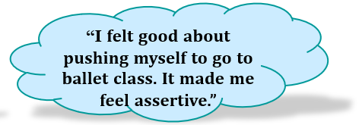
Guided Journals
For some of us initiating a conversation with a stranger can open doorways to developing connections in the community.
Repeated exposure to experiences and other people lessens the feeling of social anxiety and shyness so often felt by those of us who have experienced isolation and social exclusion.

Slide 19
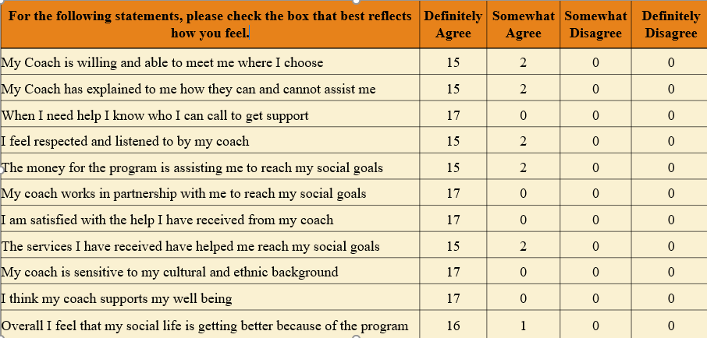
Satisfaction Survey (anonymous)
In this group 95% of respondents rated their satisfaction with the highest rating

Slide 20
Why in the world are we interested in how many times someone is hospitalized?
It really is all about proving that peer support, self-direction, and social opportunities help people to learn how to manage their own healthcare needs more effectively.
We also use these numbers (with no personal identifiers) to see if our program is helping to reduce re-hospitalization and ER usage. The agencies that fund health care are especially interested in services that help people stay out of the most intensive and expensive services

Slide 21
Hospitalization Rates
In the two years prior to entering the program participants had experienced a total of 15 hospitalizations. In the 19 months of activities 1 member had experienced a single hospitalization.
Aside from joining the program participants had no other changes in the services they were receiving.

Slide 22
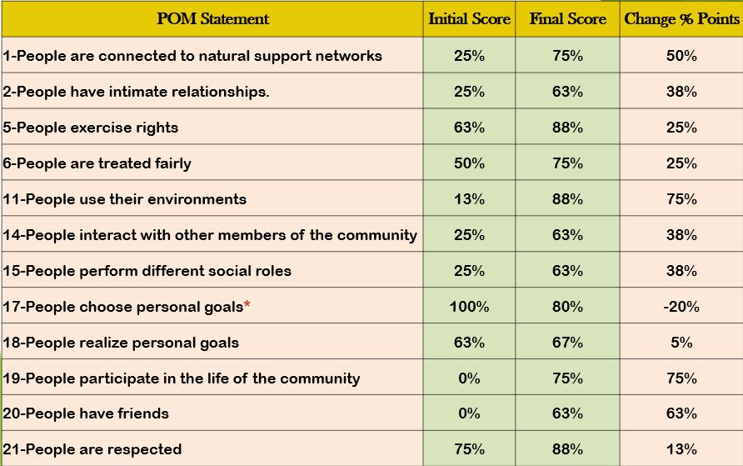
Results on 13 key indicators of Personal Outcome Measures

Slide 24
Program Conclusions
It’s My Life: Peer Partners is a unique program that has been highly successful in assisting people to end isolation and feeling of social exclusion
Our participants have found new meanings in their lives and have gone on to build lasting relationships and connections to their communities
The program is highly relevant to a whole health approach to behavioral health and self-management.

Slide 25
Introducing Personal Outcome Measures (POM)
The POM tool is based on a relaxed, in depth, structured conversation that you as the interviewer have with the person you are supporting.
Personal Outcome Measures are indicators of the individual’s quality of life as they see it, and apply to the whole person across all types of services and settings.
POM was developed by the Council on Quality and Leadership and the manual and other pertinent documents can be downloaded at no charge at http://www.c-q-1.org/the-cql-difference/personal-outcome-measures

Slide 26
Introducing Personal Outcome Measures
POM uses 21 outcome indicators.
For the purpose of Peer Partners we focus on 13 of those indicators. These 13 indicators are especially relevant in evaluating the results of participation in the program.
Following a 15 minute break we will reconvene to discus using the Personal Outcome Measures tool.

Slide 27
Patrick Hendry
phendry@mentalhealthamerica.net
Emily Skehill
eskehill@mentalhealthamerica.net

Slide 28
THANKS FOR COMING
Patrick Hendry

