Slide 1
Peer Specialists and Police as Partners Preventing Behavioral Health Crises
Kasey Moyer, Executive Director of Mental Health Association of Nebraska
Luke Bonkiewicz, Police Officer, Lincoln Police Department
Substance Abuse and Mental Health Services Administration
U.S. Department of Health and Human Services

Slide 2
Disclaimer Slide
This webinar was developed [in part] under contract number HHSS283201200021I/HHS28342003T from the Substance Abuse and Mental Health Services Administration (SAMHSA), U.S. Department of Health and Human Services (HHS). The views, policies and opinions expressed are those of the authors and do not necessarily reflect those of SAMHSA or HHS.

Slide 3
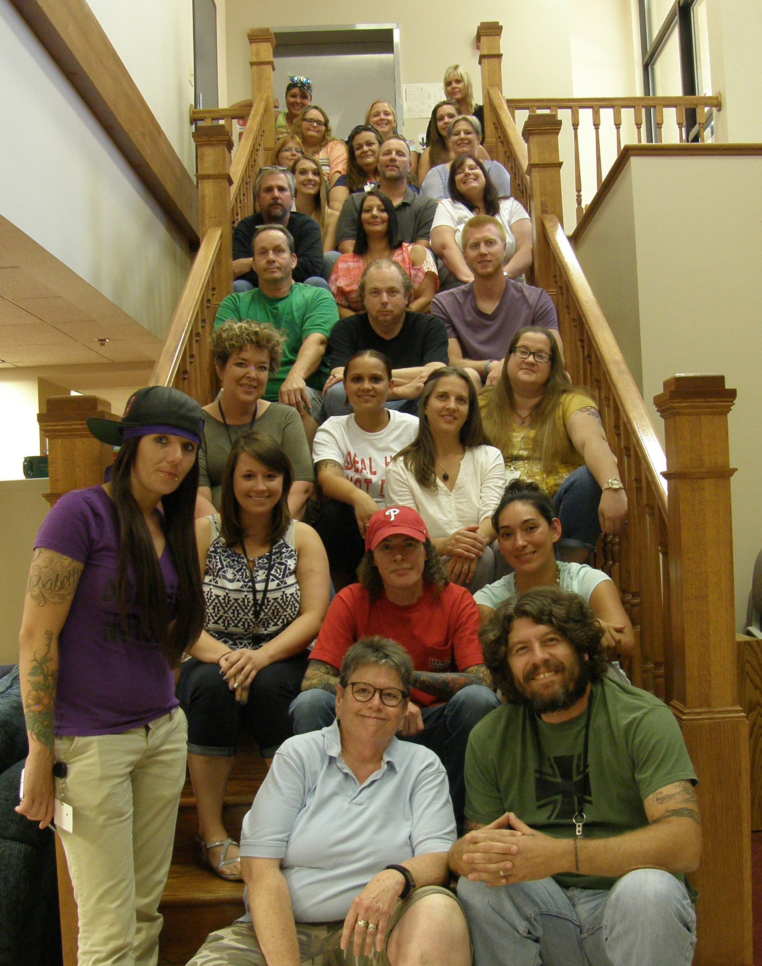
Mental Health Association of Nebraska
Peer Developed
Peer Implemented
Peer Operated
Person Driven!

Slide 4
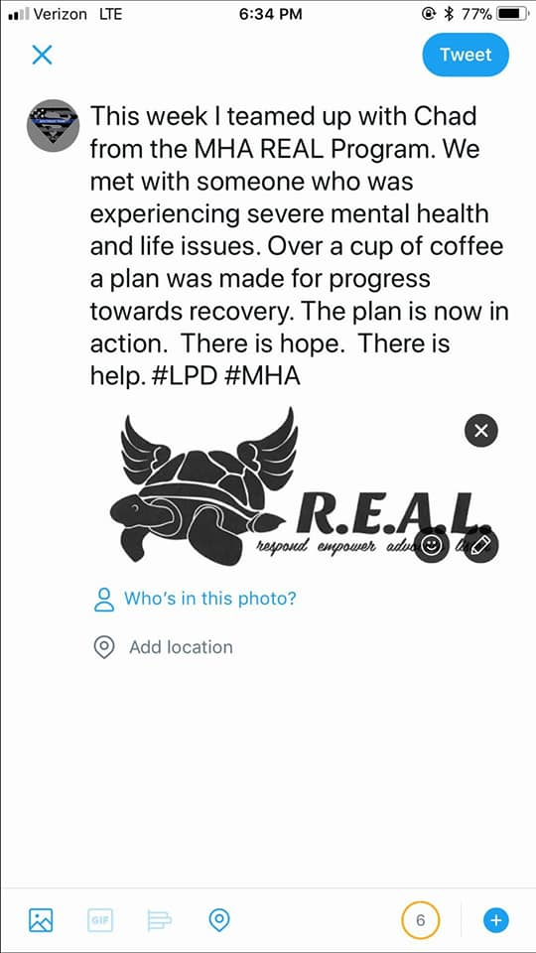
REAL Program
2,200 Referrals
Over 300 different Officers have referred
Also referrals from private physicians, bus drivers, schools, Sheriffs Dept., providers, family and self.
Completely voluntary
24/7 peer support

Slide 5
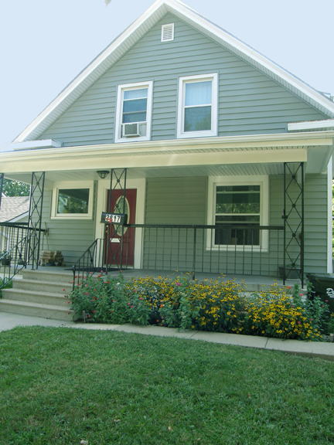
Keya House/ Warmline
Approximately unduplicated 800 guests
Average stay is 5 days
Average 350-400 calls/month
24/7 peer support

Slide 6
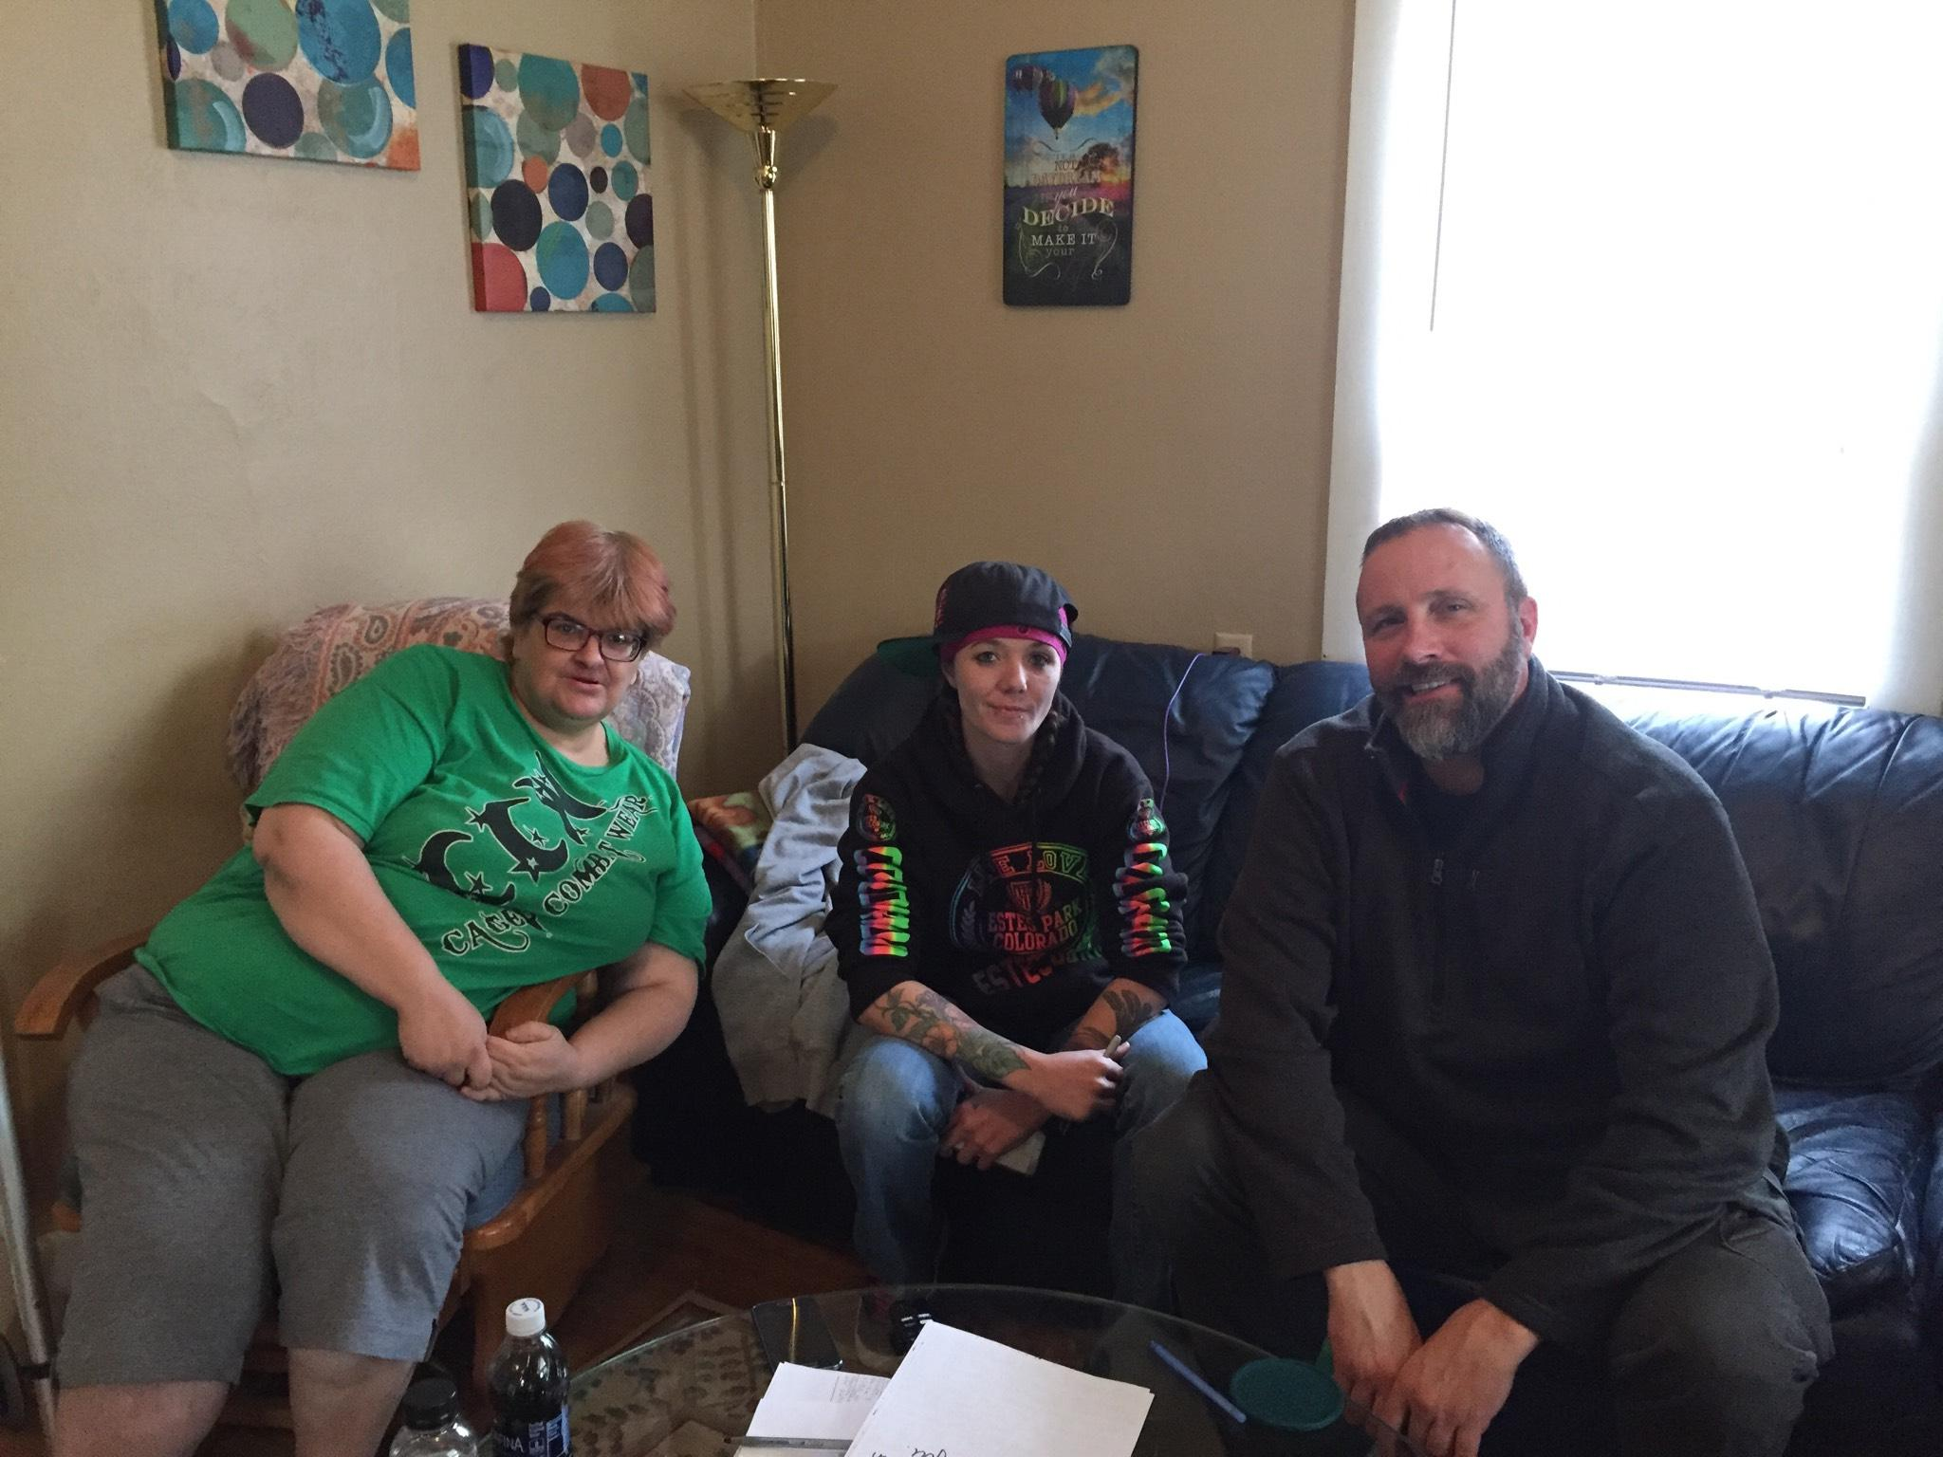
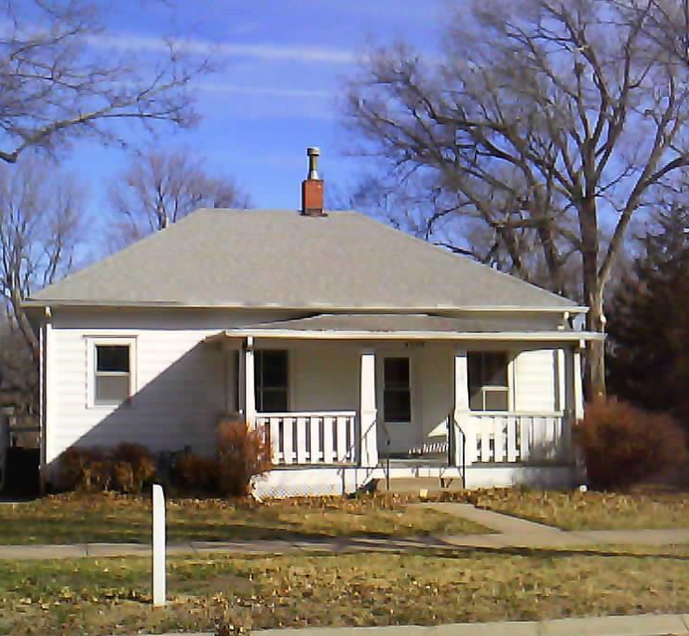
Honu Home
80 Guests Stays
Average stay is 66 days
24/7 support services

Slide 7
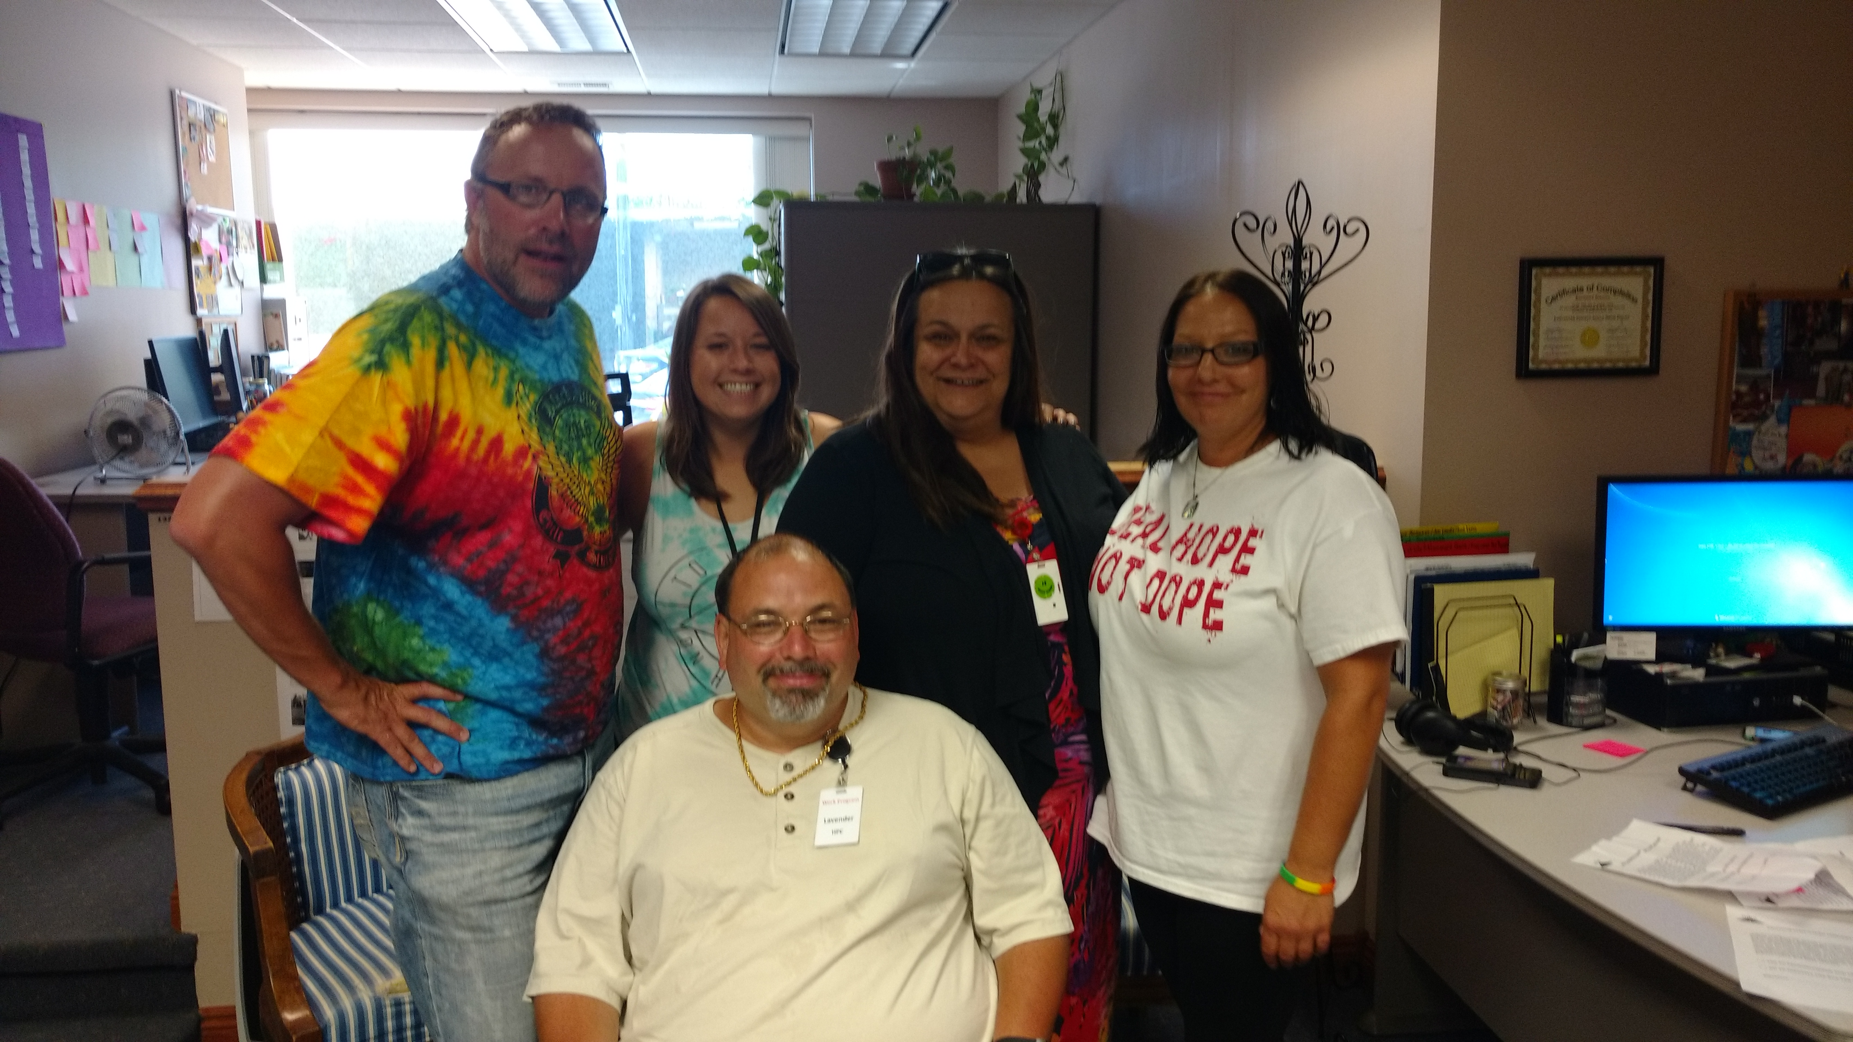
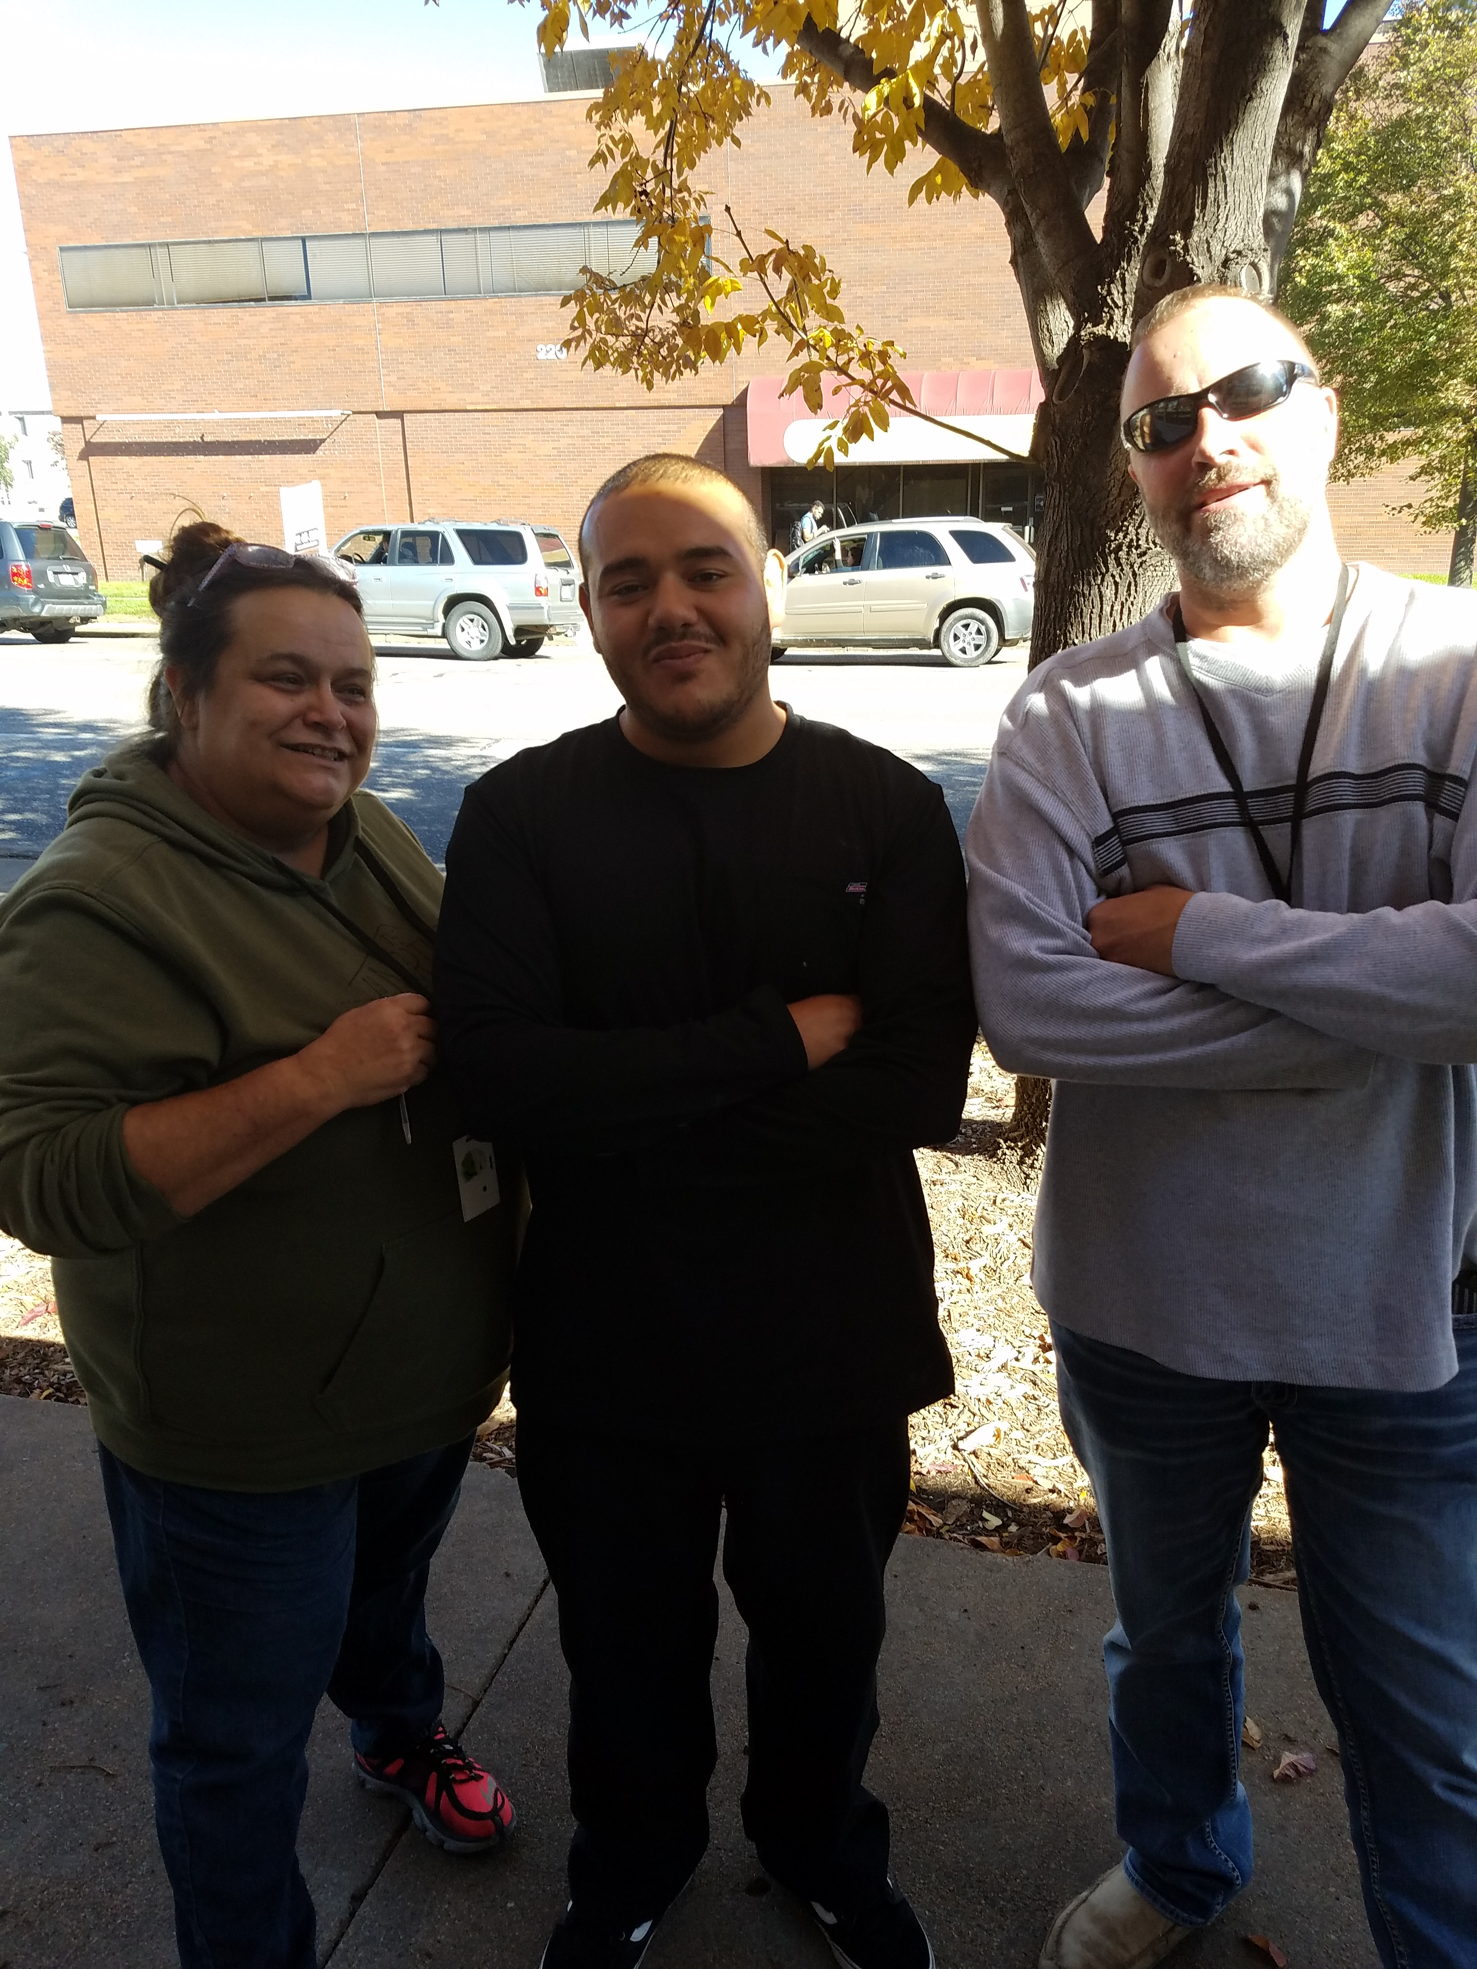
Supported employment
140 participants in 2016-2017
112 we know are still working
56 in progress
33 have obtained employment
MHA- Employees
10 peers DOC
10 peers Jail/Drug Court
3-peers mental health board commitment
3- peer veterans

Slide 8
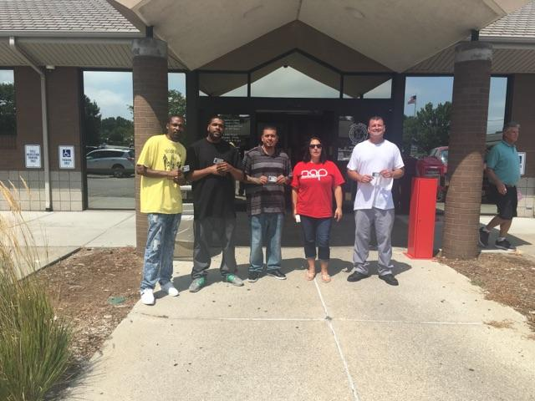
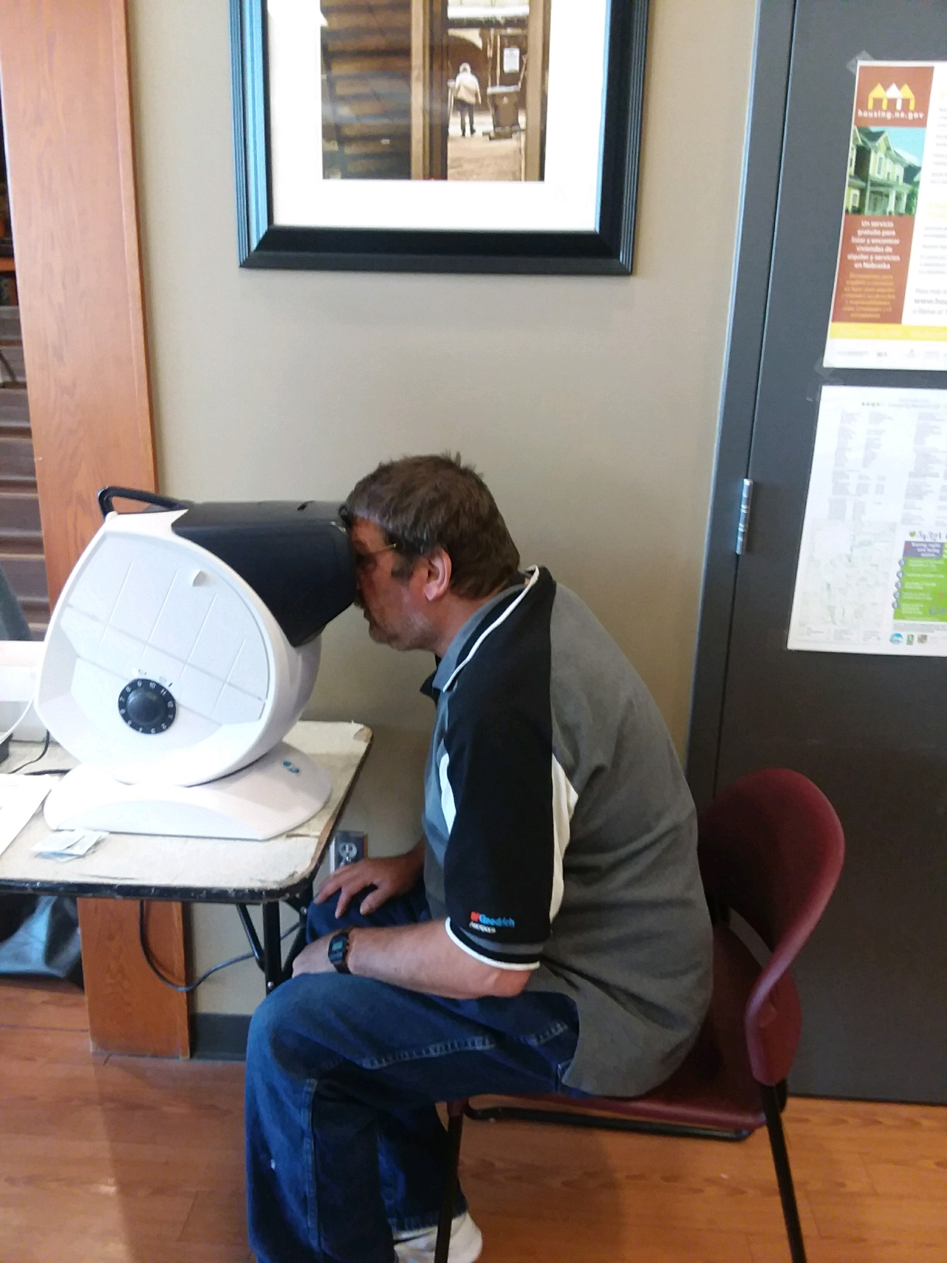
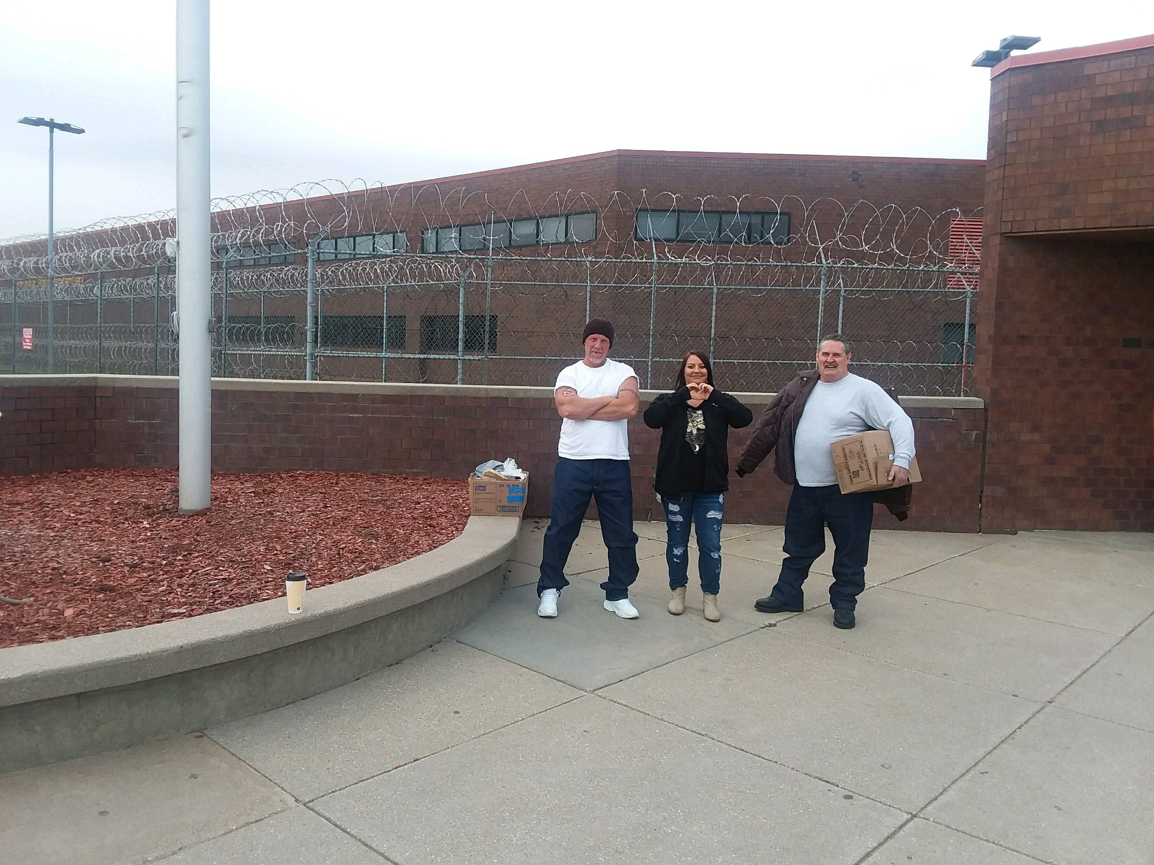
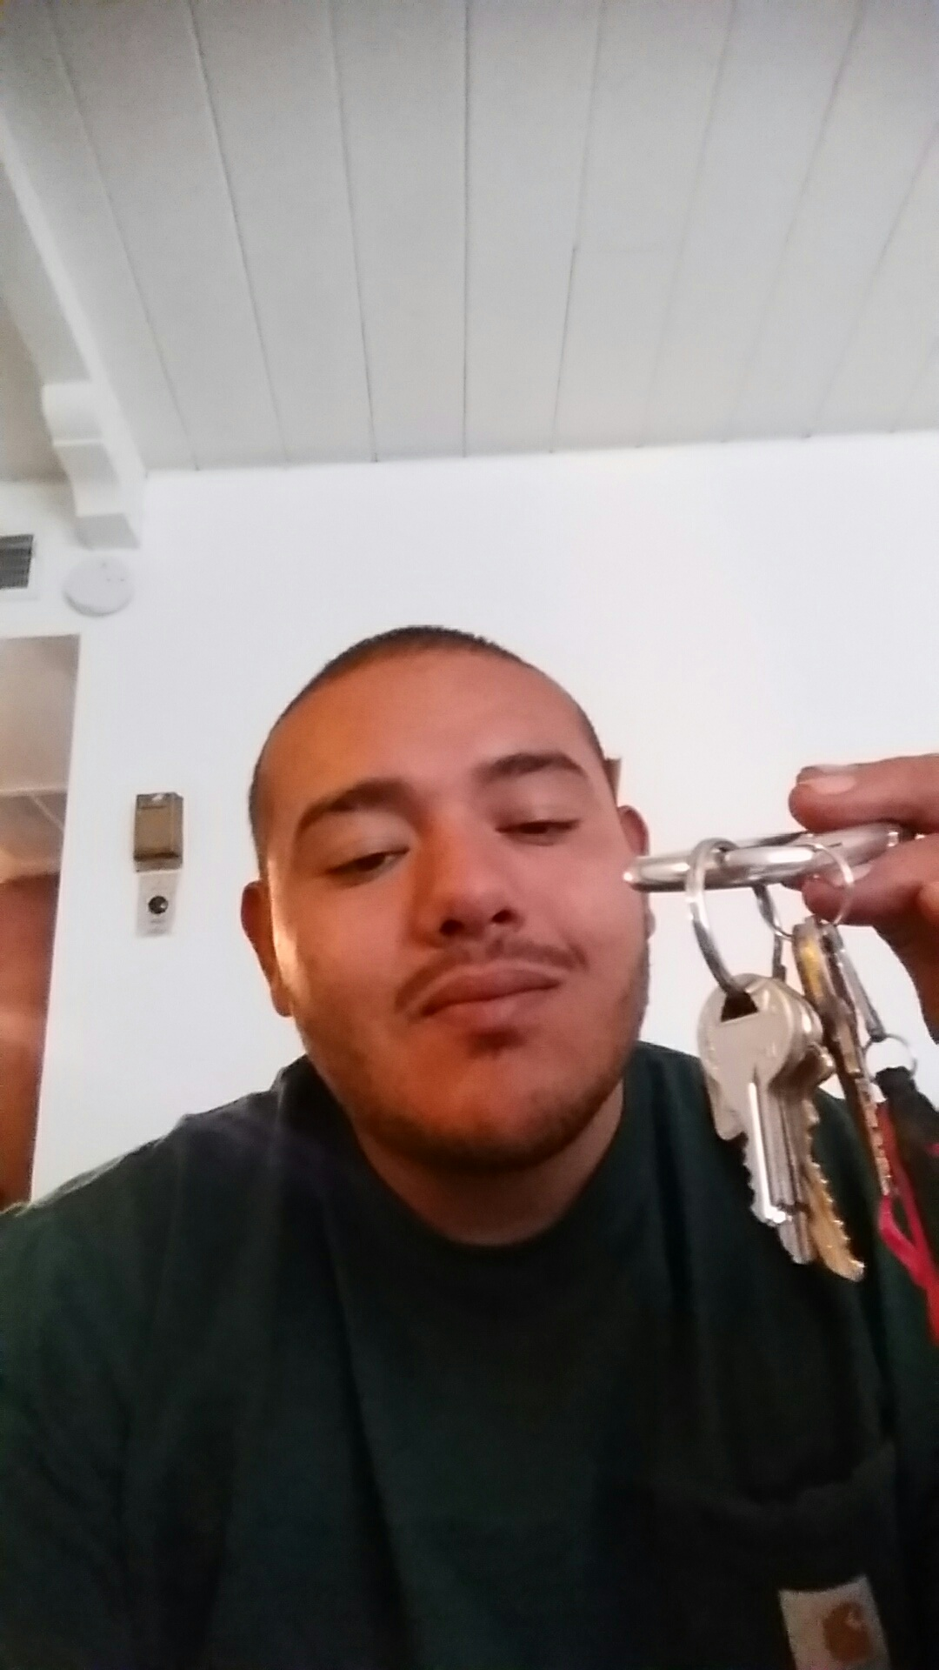
Peer Outreach
Housing
Furniture
Food Nets
Medical Appt.
145 individuals served
47 current

Slide 9
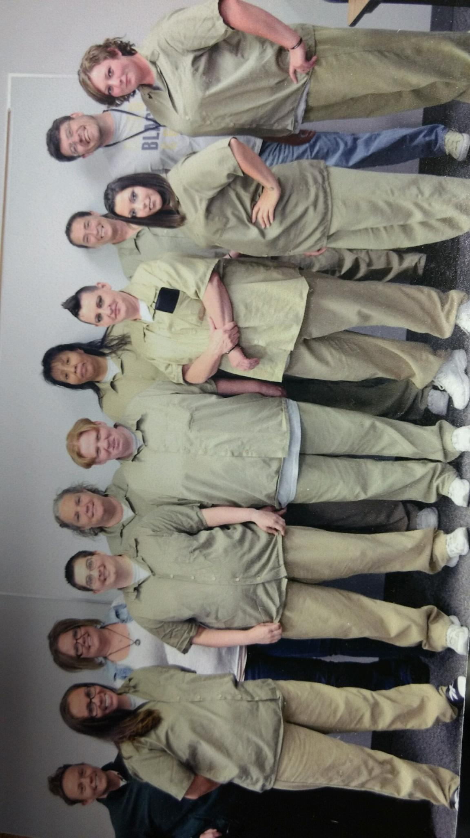
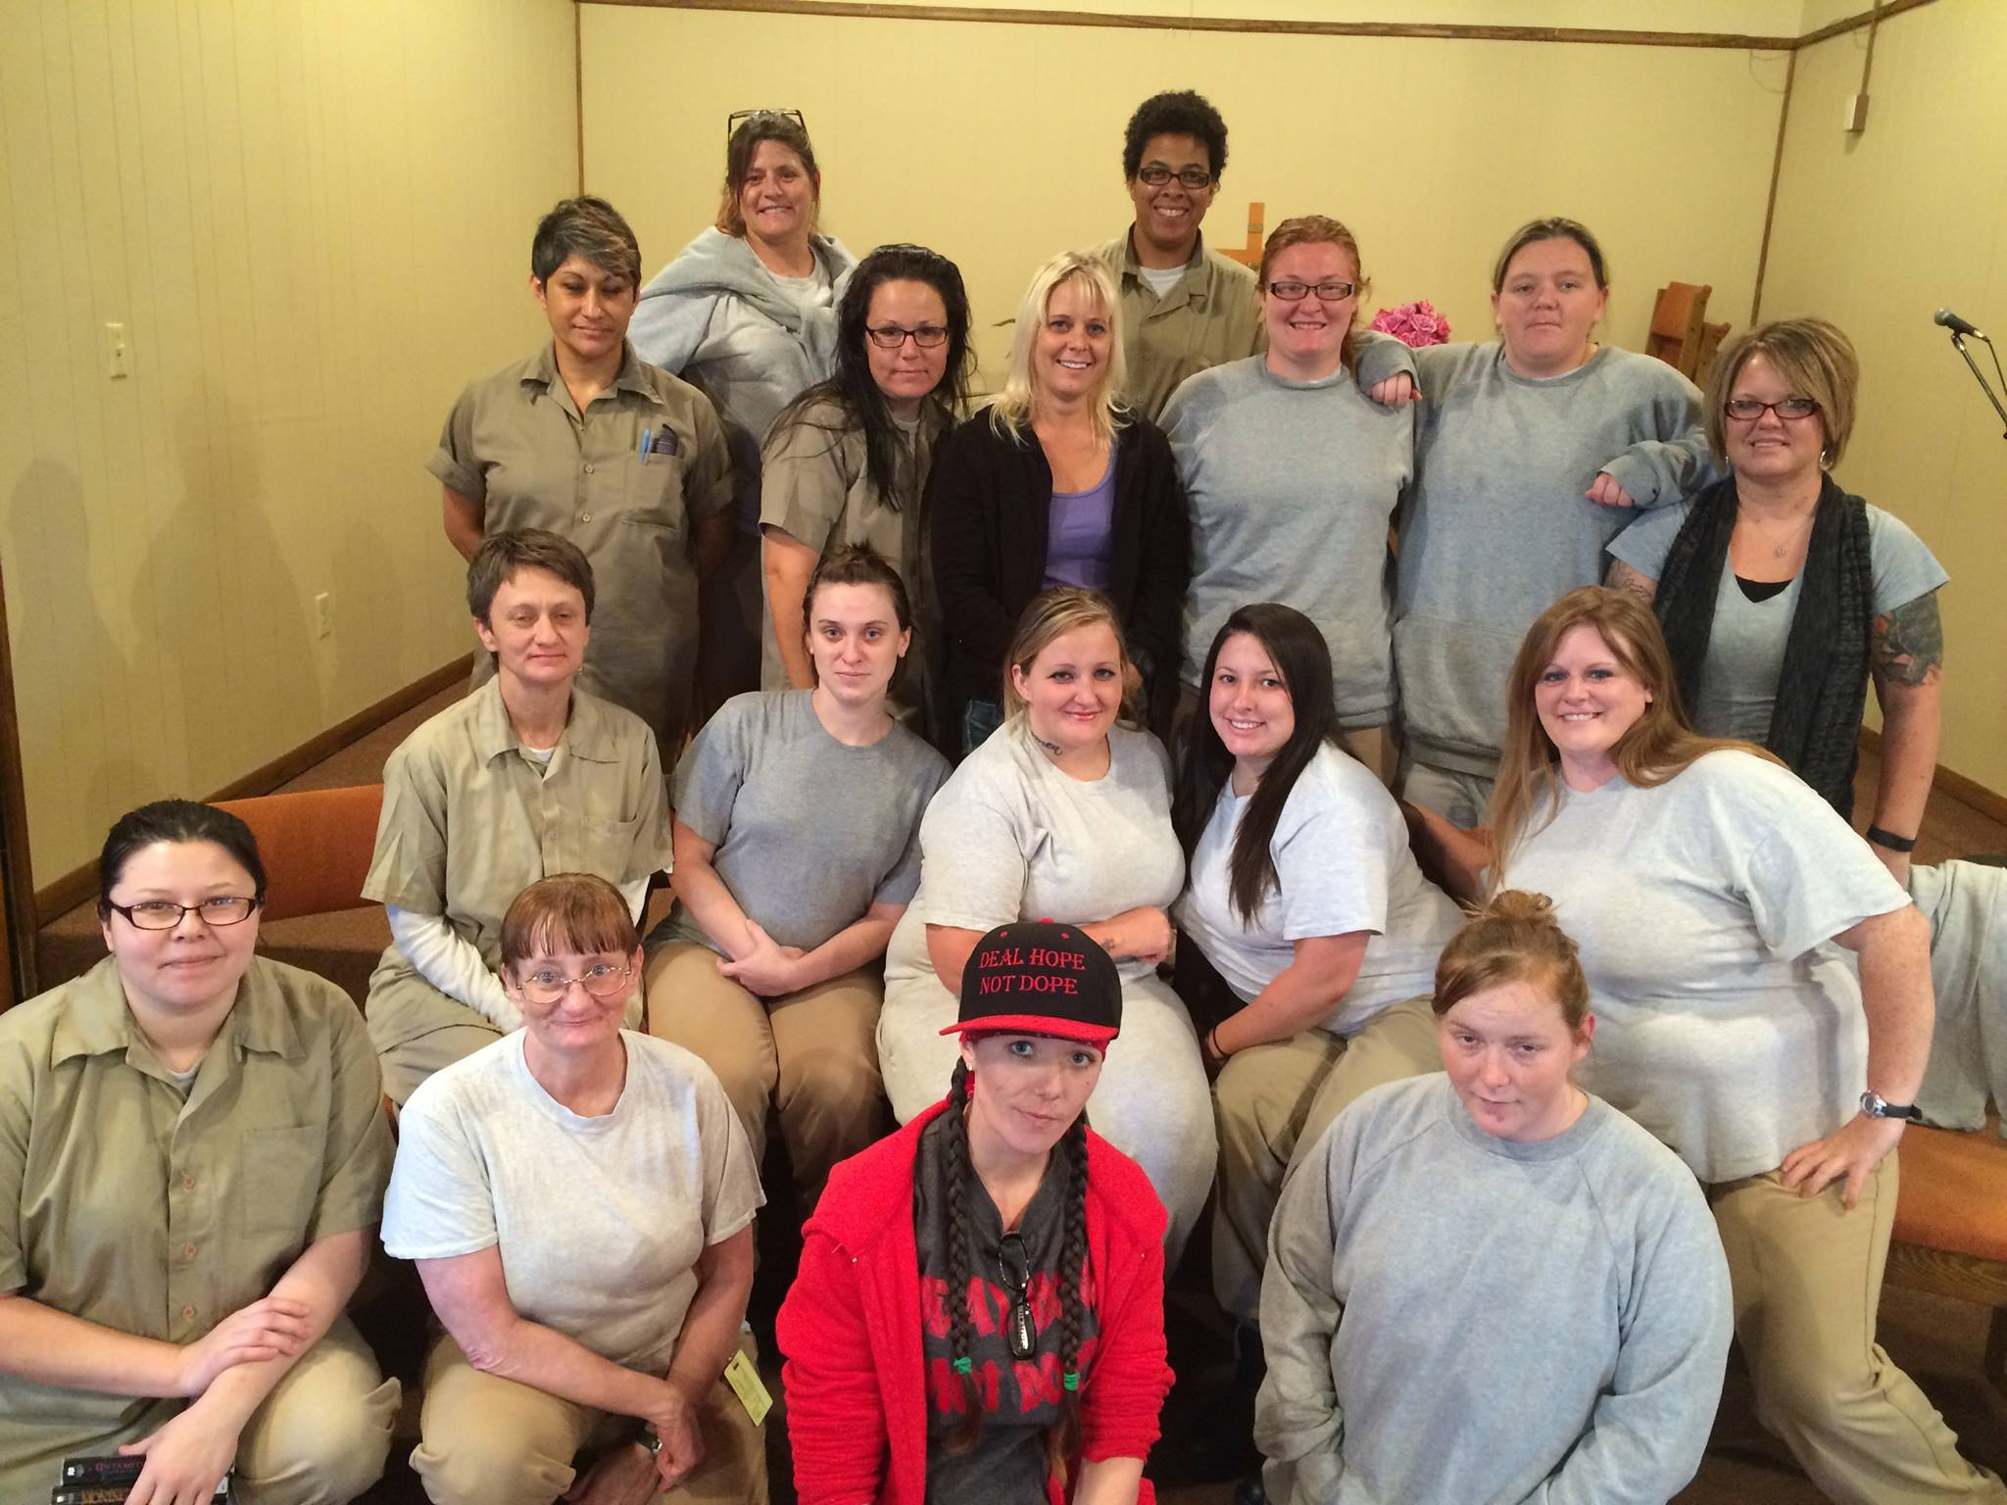
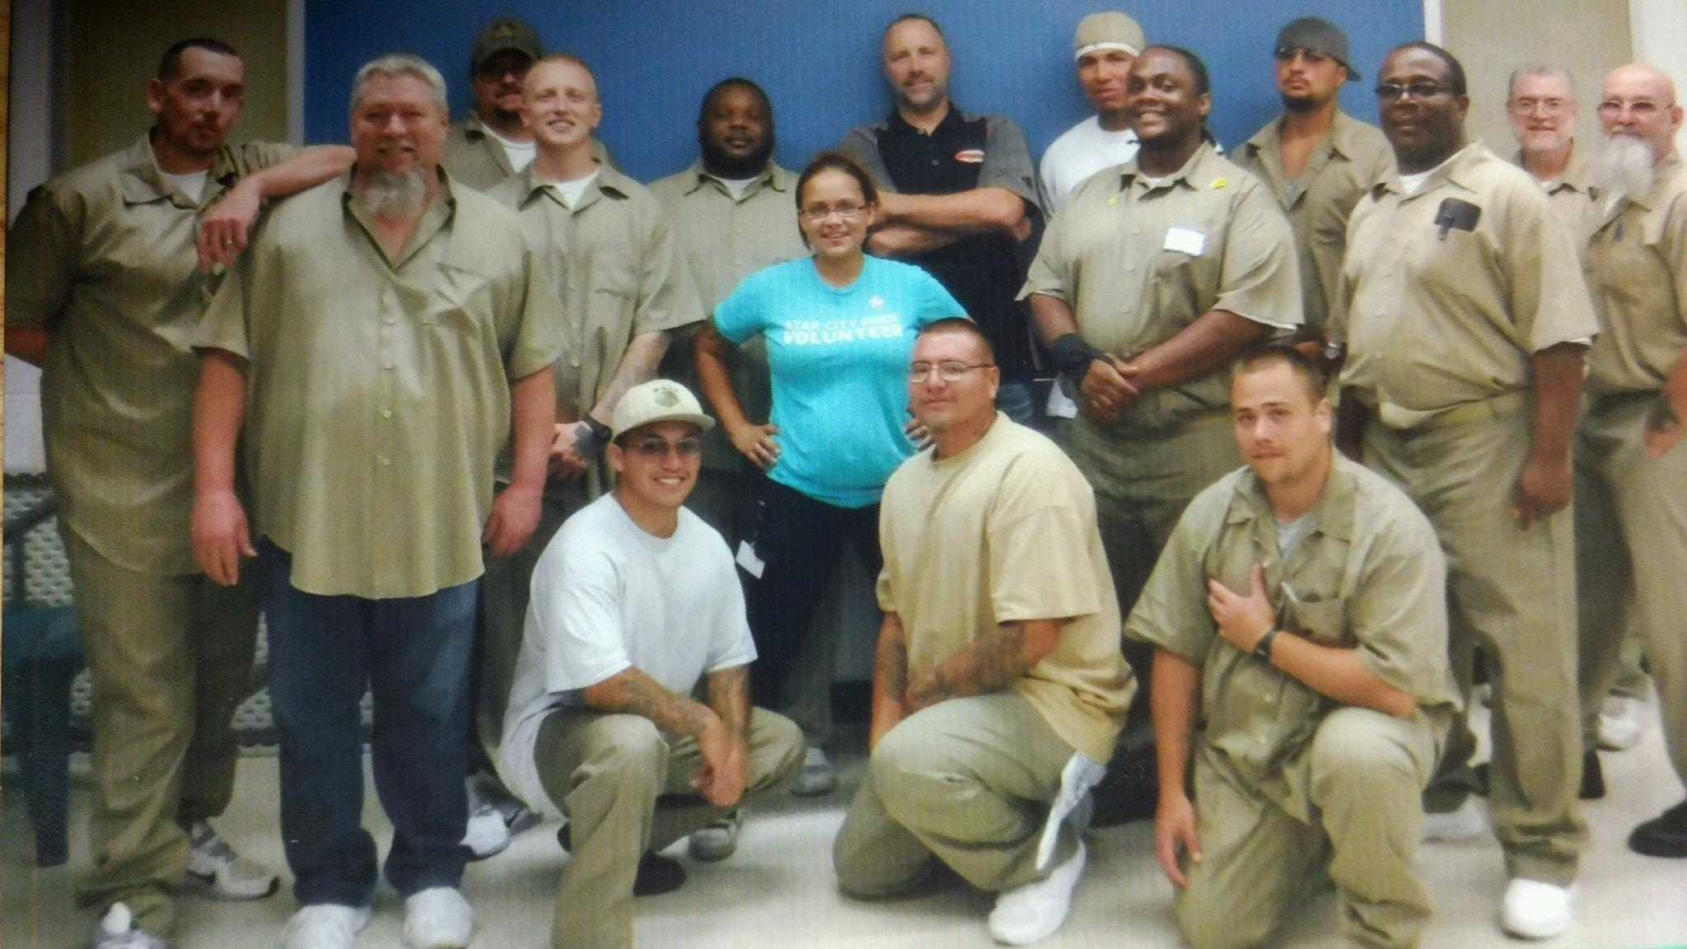
Peer Support Inside the walls

Slide 10
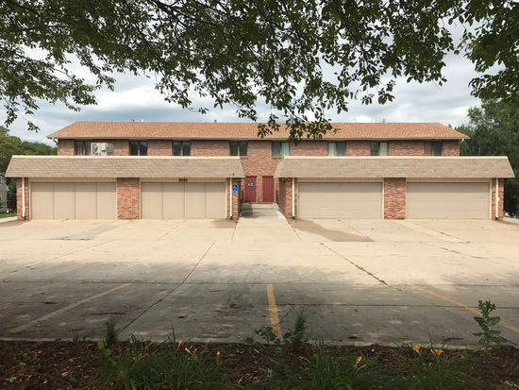
HONU Expanded
20 individual bedrooms/ 14 bath
Serving those within 18 months of release from DOC
Serving those living with significant MH or SA who wish to not live on their own
Assisting Law Enforcement with individuals who don’t need EPC but additional support

Slide 11
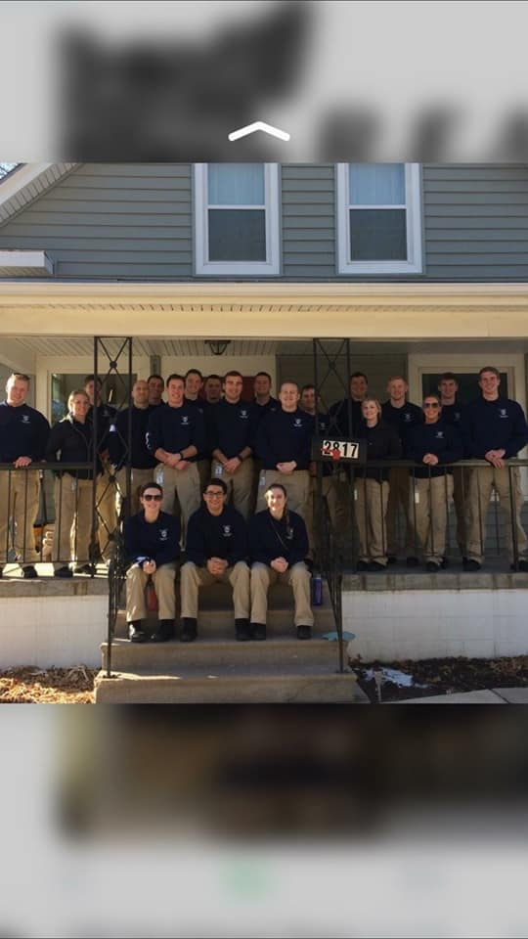
Law Enforcement Training
New Recruits
Dispatch
BHTA Training
9th annual
Averaging 65 officers per training

Slide 12
What is the R.E.A.L. Program?
A way for officers to connect citizens to MH resources following a call for service
Officer e-mails referral to MHA after CFS
Peer-specialist then contacts mental health consumer
Free
Voluntary
Non-clinical

Slide 13
How do LPD Officers Make Referrals?
E-mail sent from LPD officer to MHA
Three components of referral:
Type of incident (e.g., suicide attempt)
Consumer’s contact information
Brief description of incident

Slide 14
R.E.A.L. Program—Evaluation
GENERAL QUESTIONS
What is the R.E.A.L Program?
How do LPD officers use the program?
Has the program benefited mental health consumers and LPD? If so, how?

Slide 15
What is the Program’s Impact?
Data: 410 referred individuals, 365 non-referred individuals (N=775)
NOT a randomized, controlled experiment
Numerous control variables

Slide 16
What is the Program’s Impact?
Three outcomes following a MHCFS
Whether individuals were arrested
# of MHCFS generated
Whether individuals were EPC’d
Three points of time (12, 24 & 36 months after MHCFS)
Methods of Analysis
Logistic Regression
Negative Binomial Regression

Slide 17
What is the Program’s Impact?
Results—disappointing news first
NO EFFECT on any outcome at 12 month period
NO EFFECT on being arrested at any time period

Slide 18
What is the Program’s Impact?
Results—better news!
Moderate negative effect on # of future MHCFS at 24 and 36 months.
Effect seems to grow stronger over time
Moderate negative effect on future odds of being taken into EPC at 24 and 36 months (33% & 44%)
Again, effect seems to grow stronger over time

Slide 19
What is the Program’s Impact?
Effect greater for individuals with lengthier MHCFS histories
Effect seems to grow stronger over time

Slide 20
What is the Program’s Impact?
Substantive Takeaways
It takes at least 12 months (and probably closer to 24 months) to see results
Peer support program especially effective for those with longer/possibly more serious MH histories
Effect of program grows stronger over time

Slide 21
Future Research
Why exactly does the program work?
What aspect is most beneficial?
Need for replication and verification
Need to identify procedures that can be standardized and shared

Slide 22
Questions?

